Slide 1
Computer Science 2 Final Project

Slide 2



Consolidate the knowledge obtained throughout the Computer Science 2 course.
Coding and design skills
Logical and algorithmical thinking

Slide 3

What is the project about?
Analysis of a data set using Java
For this project, you will use Java to analyse a data set of your choosing.
Your program will read, process, and analyse information.
At the end, you should display some results or analysis of the dataset you chose.

Slide 4
What is the project about?
Some data sources you can use:
Kaggle.com (https://www.kaggle.com)
INEGI (https://www.inegi.org.mx)
Data.gov (https://catalog.data.gov/dataset)
As a minimum, the dataset you pick should have at least 300 entries.

Slide 5
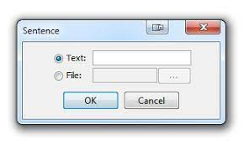
What is the project about?
The program should allow the user to select the location of the data to analyze.
Results must be calculated by the program. If the datasource changes, the results should change too.

Slide 6
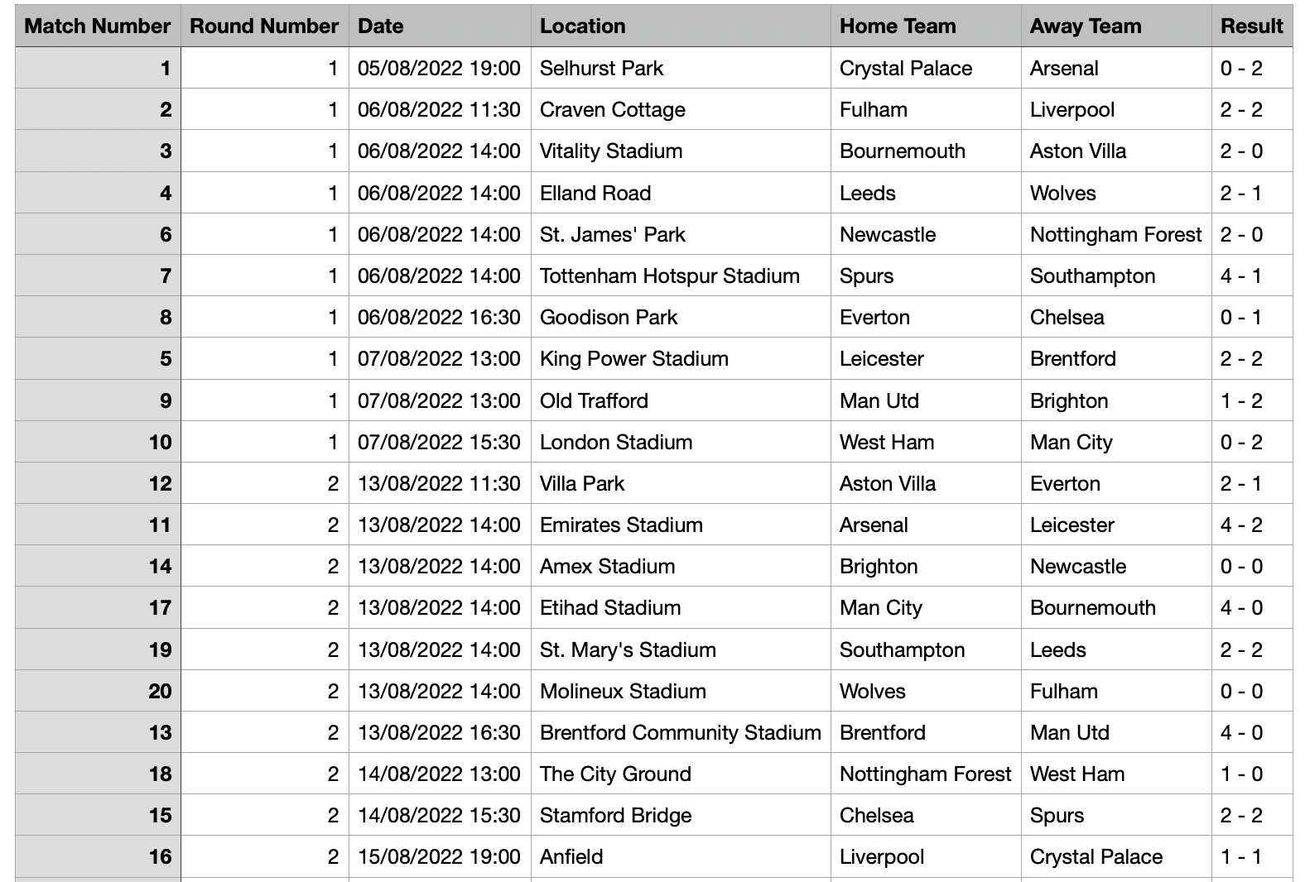
Example 1:
Calculate the champion of the Premier Leage.
Data source: results for all games played in the Premier League 2023-2024.
Champion:
Man City
Team with most scored goals:
Chelsea
Team with most games at home:
Fulham

Slide 7

1. Design – Part 1
Due date: April 8th @ 6:00 AM
Deliverable: Submit a short project description of what you are going to do. It must include:
Brief description of what the program will achieve
Dataset that you have selected. Source for the information
Format: Written submission (1-2 paragraphs is enough) in a Canvas text entry box

Slide 8
1. Design – Part 2
Due date: April 15th @ 6:00 AM
Deliverable: Hand in a document with a short description of the Java classes that you will code in your project.
Format: Design Template document in Canvas.

Slide 9

2. Coding
Due date: April 22nd @ 7:30 AM
Deliverable: Hand in all project source code.
Consider that the project should include at least three classes, with the following functionality:
One class that models the selected object
Two classes that handle and administer the GUI (one per Window)

Slide 10
2. Coding
La funcionalidad mínima esperada es:
Clase para modelar el objeto elegido:
5 atributos, correctamente encapsulados
1 constructor
Getters y setters necesarios para interactuar con la clase
Métodos para realizar los cálculos
GUI
At least 2 windows
2 buttons
2 images
Labels and input boxes as needed

Slide 11
2. Coding
All project files must be submitted to Canvas. This includes:
Classes
Folders
Images
The file must be submitted as a .zip file
Links to external hosting sites (Dropbox, Google Drive, iCloud, etc) will NOT be accepted.

Slide 12

3. Demo
Demo: Week of April 22nd @ 7:30 AM
Deliverable: Every team will do a live-demo in front of the class of their project. 5 minutes

Slide 13
Final Comments
Teams of up to 3
Grading (20 points of the final grade)
Design: 5 points
Coding: 10 points
Demo: 5 points

